Slide 1

Black Horse Hill Infant School
Year 1 Curriculum Evening
2025-26
Notes:
Welcome to our Y1 curriculum evening.
Thank you for coming.
INTRODUCTIONS – Chris – Class Teacher , Miss Barnes – TA – Mon-Friday , CJ in afternoons and TC Mon-Wed

Slide 2
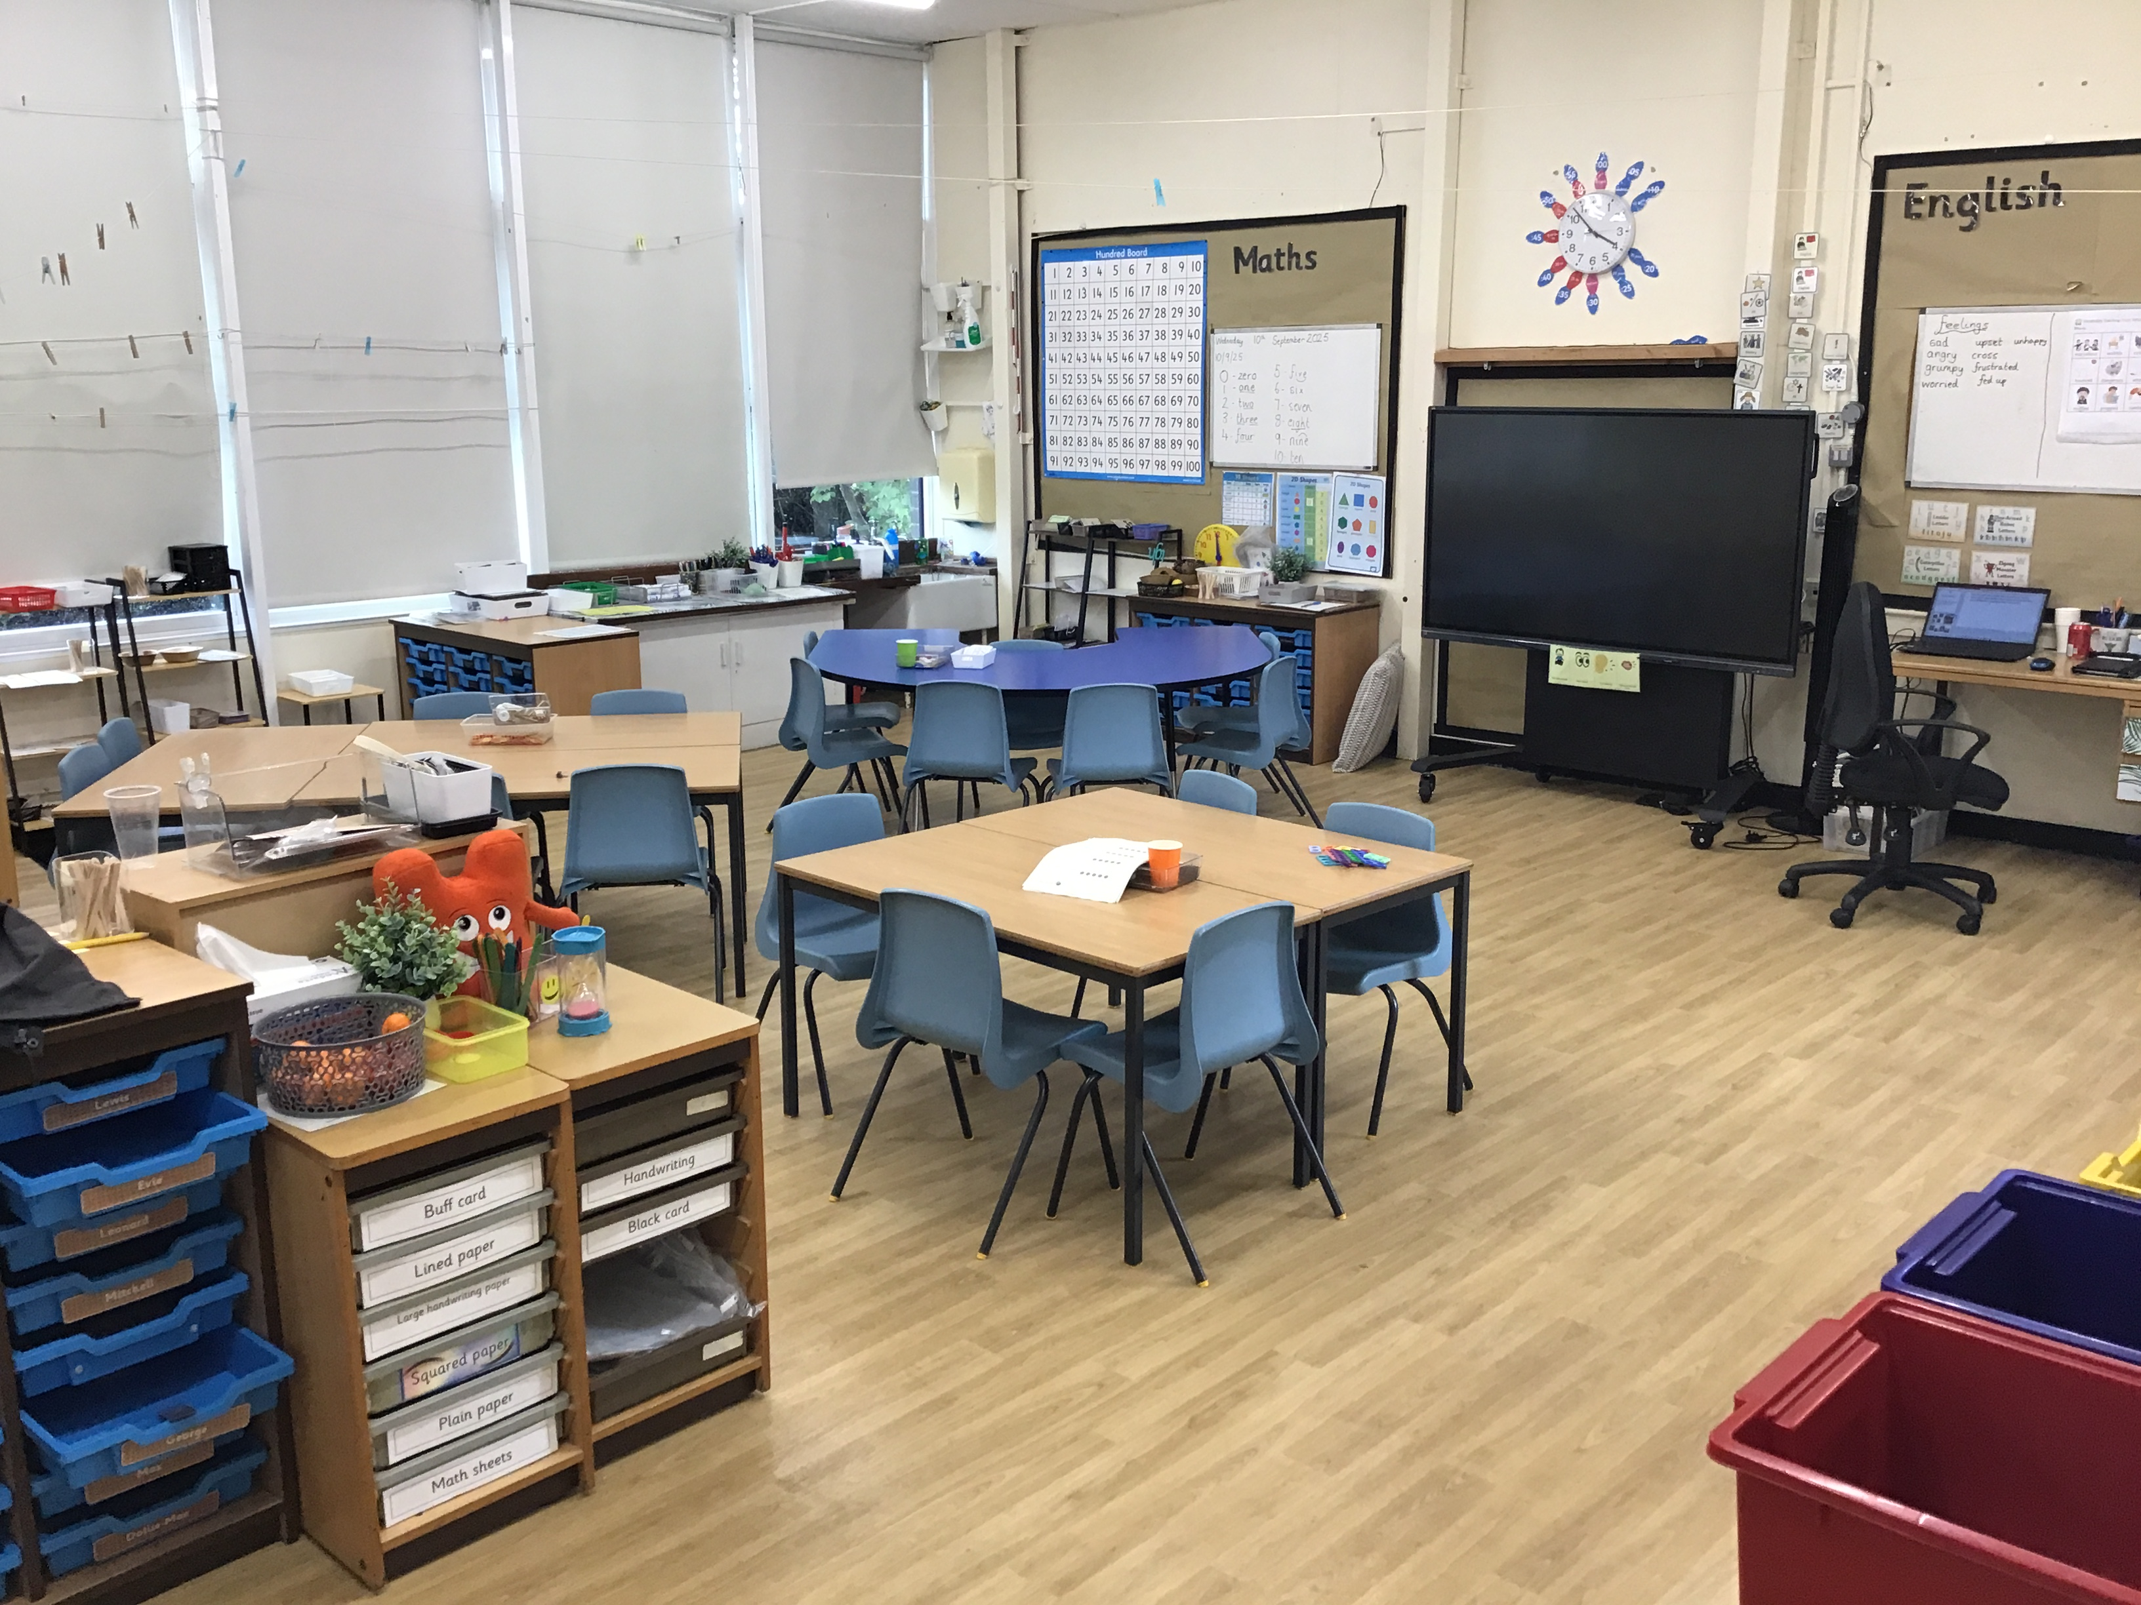
The Classroom

Slide 3
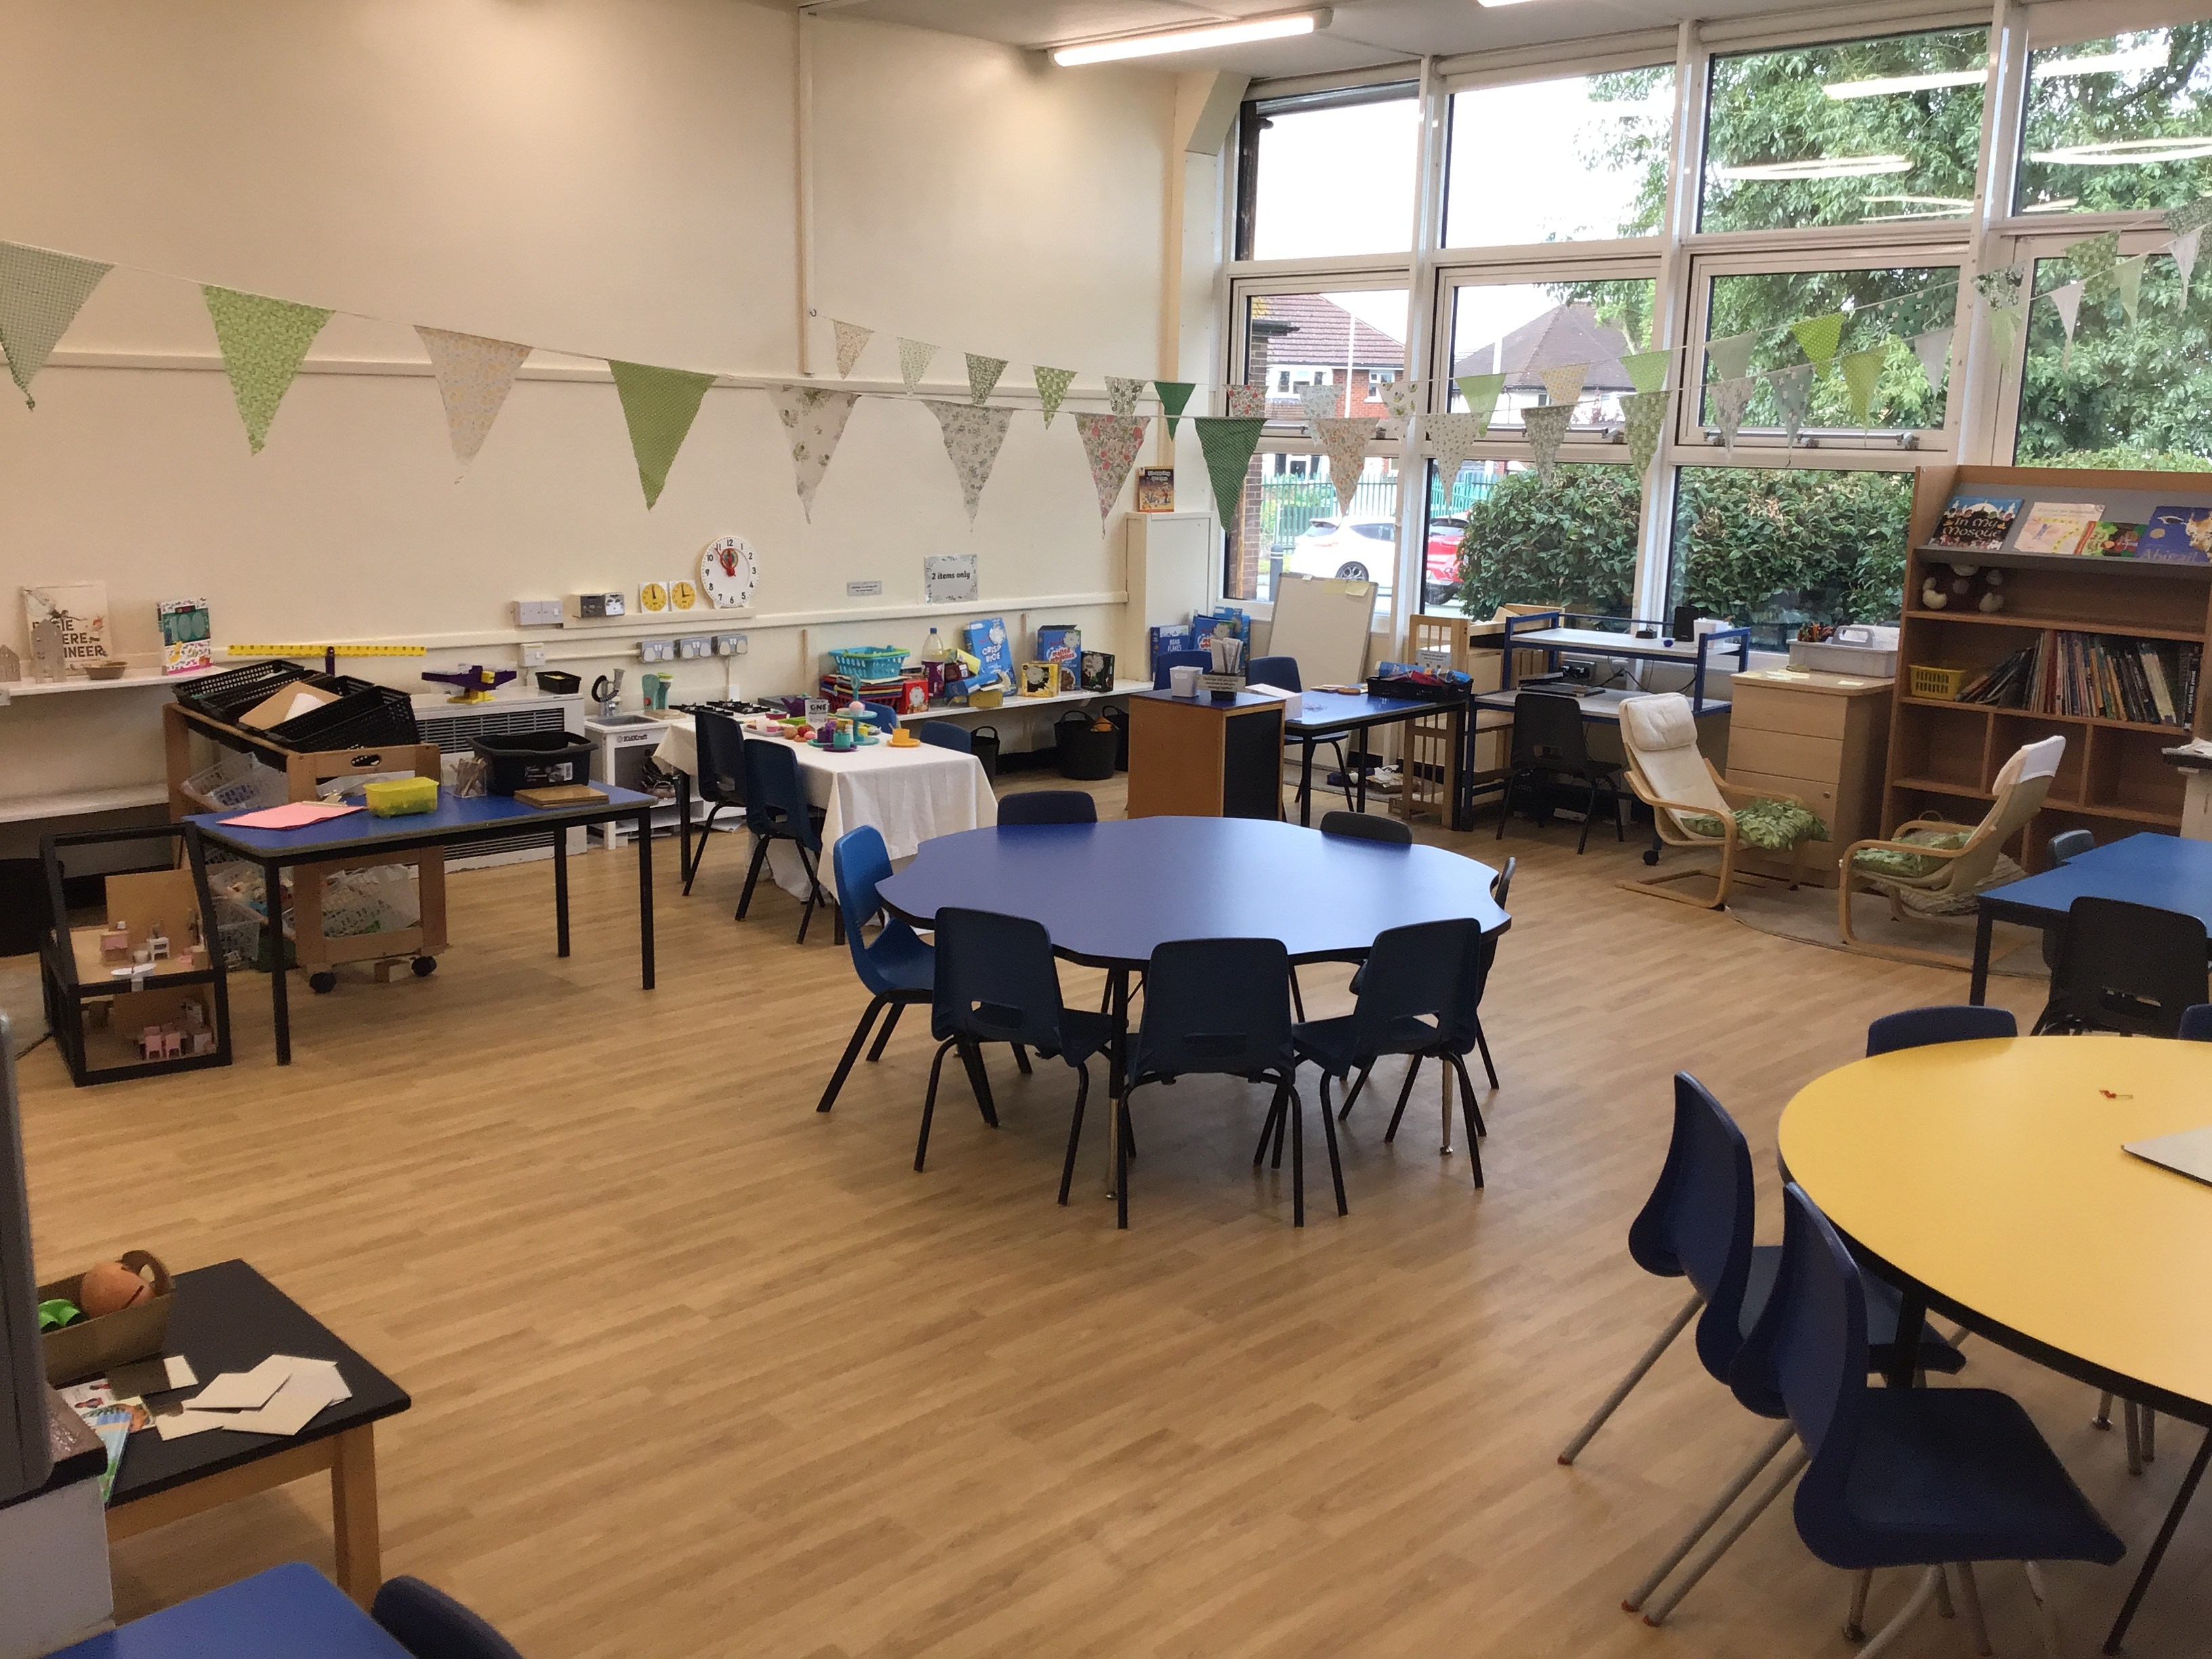
The Workshop

Slide 4
Intentions of this evening
Explain the difference between Foundation Stage and Year 1 expectations
Discuss the National Curriculum
Summary of the units covered over the year
End of year expectations
Notes:
How it I different – how it will feel for the children.
Children have moved from following EYFS (play-based pedagogy) to the National Curriculum. New curriculum in 2014 – INTENT / IMPLEMENTATION / IMPACT.
There will still be ‘continuous provision’ child initiated time but slowly over the year this will become more adult directed for ‘most’ children.
End of year expectations – HANDOUT. Children’s progress is reported to you along the year.

Slide 5
Structure of our day
When your child enters in the morning they will complete a morning starter activity.
After registration we teach phonics and guided reading . We then teach maths and after a playtime break, we teach English. In the afternoon, maths mastery and foundation subjects will be taught.
Phonics takes place every day.
Guided reading takes place on a Monday, Tuesday Wednesday and Thursday.
PE is on a Friday.

Slide 6
Independence
As the year progresses we expect the children to develop independence concerning the following:
changing reading for pleasure books;
getting letters, homework, reading books out of their bags;
going to the toilet and washing their hands;
listening and concentration;
morning/afternoon activities.
General etiquette e.g. coughing and sneezing.
Notes:
With support until necessary

Slide 7
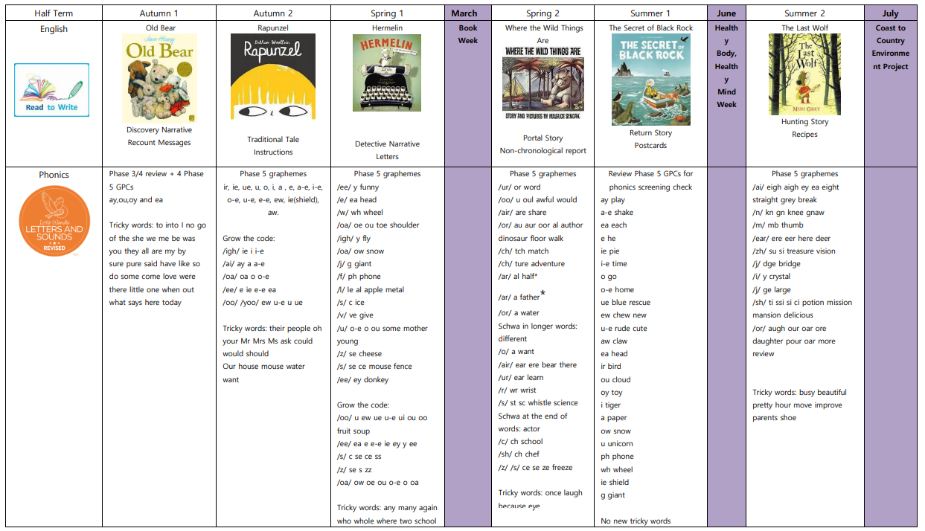

Slide 8
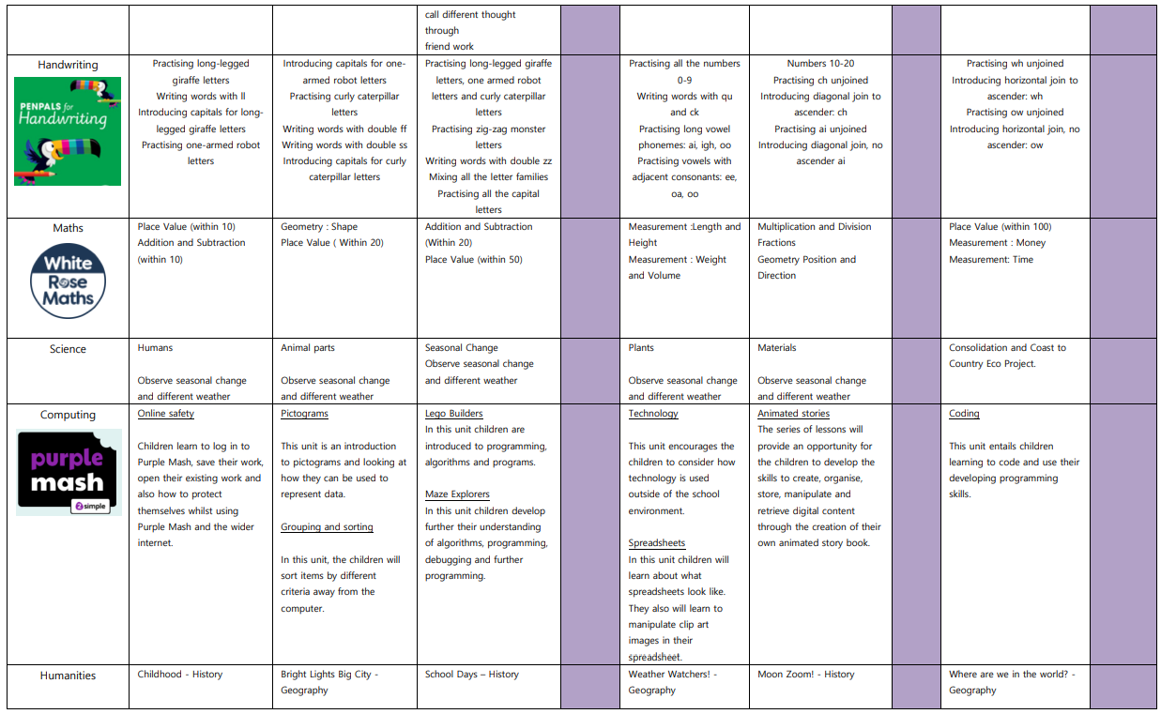

Slide 9
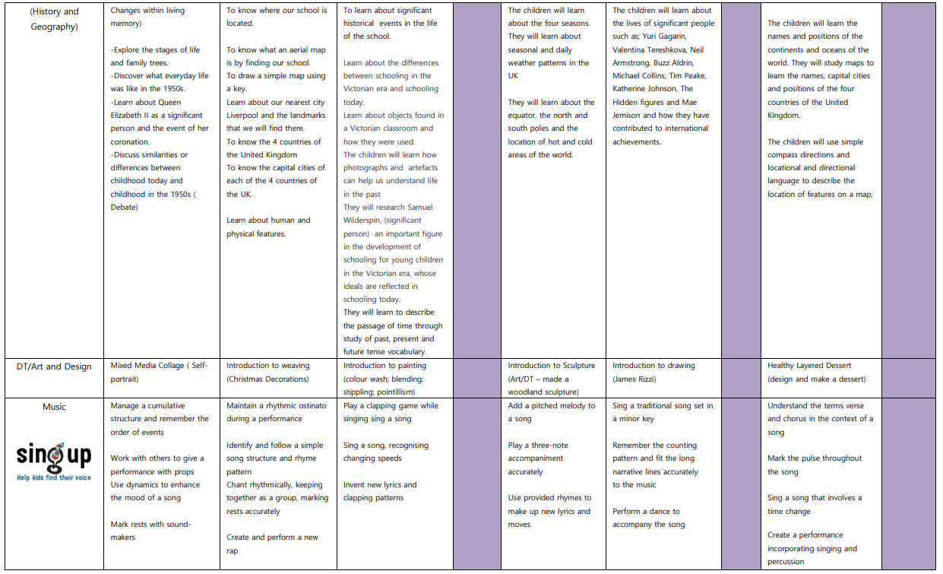

Slide 10
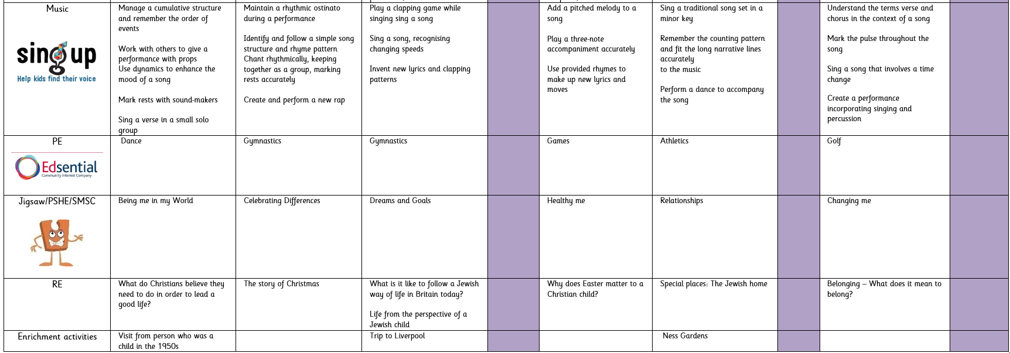

Slide 11
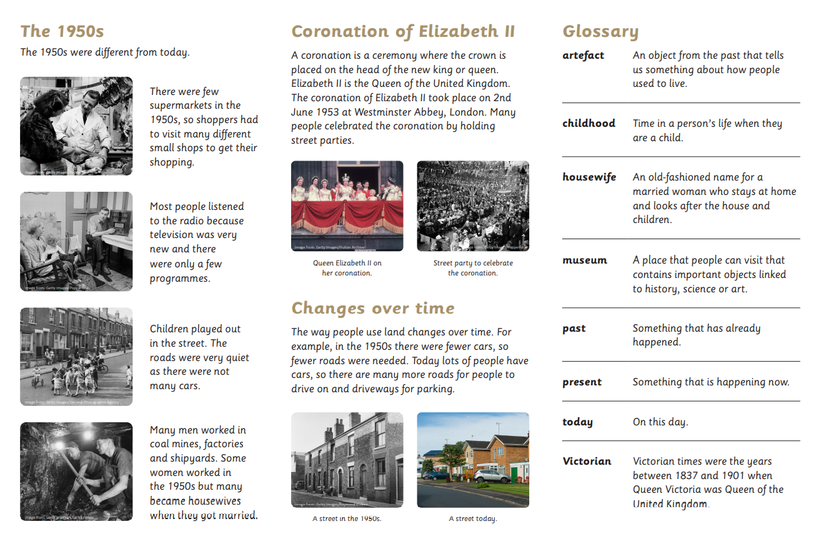
Knowledge Organiser
A knowledge organiser is a document that supports the key learning the children will take part in throughout a unit. There is a knowledge organiser for each unit we use from curriculum maestro and can be found in the homework section of the school website.

Slide 12

National Curriculum Expectations
Find the Fibs…
Notes:
New Curriculum 2014 – Intent / Implementation / IMPACT

Slide 13


Phonics
Phonics is learning Grapheme Phoneme Correspondence (alphabetic system; letters represent speech sounds).
Grapheme
Written representation of sound.
Phoneme
Smallest unit of sound – can be represented by one or more letters (eg book, cup, could).
sh
igh
m
ph
Notes:
Taught 1-2-1 if appropriate
Small groups
Gudided reading and phonics are a priority and a big part of our school day
Decoding – but also inference / prediction

Slide 14
Phonics helps us to read by segmenting and blending
*Segmenting: Identifying the individual sounds in a spoken word, e.g. ‘hat’ and writing down or manipulating letters (e.g. magnetic) for each sound to form the word /h/a/t/
Blending: Recognising the letter sounds in a written word, e.g. /c/ /u/ /p/ and merging or synthesising them in the order in which they are written to pronounce/read the word ‘cup’.
*segmenting helps us to spell
Notes:
Taught 1-2-1 if appropriate
Small groups
Gudided reading and phonics are a priority and a big part of our school day

Slide 15
But…
Approximately 44 phonemes in our English language but only 26 letters…
  I saw a dinosaur roar four times at the door and implore his mother to let him in.
Notes:
We have to make these complexities explicit
Move from a learning a SIMPLE code to a COMPLEX code

Slide 16
p | ai | n

Slide 17
s | t | ay

Slide 18
th | ey

Slide 19
s | l | eigh

Slide 20
s | t | r | aigh | t

Slide 21
p
l
a
n
e

Slide 22
Same phoneme can be represented in more than one way
Common spellings |  |  | Rare spellings
/ai/ | /ay/ | /a-e/ | /ea/ | /aigh/ | /eigh/ | /ey/ | /eig/
afraid | play | plane | great | straight | sleigh | they | reign

Slide 23
Three key principles to understanding
  1) A phoneme can be represented by one or more letters in the corresponding grapheme, e.g. /a/, /sh/, /igh/, /ee/.
  2) The same grapheme can represent more than one phoneme, e.g. meat, deaf, great.
  3) The same phoneme can be represented in more than one way, e.g. rain, may, lake.

Slide 24
Tricky words
English language is not completely phonetically regular
  e.g. said; was
Notes:
We have to make these complexities explicit

Slide 25


Reading
Our whole school approach
We read 4 times per week.
Day 1 - Decoding and prediction.
Day 2 - Fluency
Day 3 - Prosody
Day 4 - Comprehension
Year 1 decodable Little Wandle reading books (Collins Big Cat books) will be sent home on a Thursday and the previous week books will be collected in.
The expectation is that children read every night at home.
Reading Raffle!
Reading for pleasure book – children are trained to swap these independently as often as they wish.

Slide 26

Reading at home – booklets to take home
Reading is typically taught through Phonics, English and Guided Reading and is modelled to the children.
It is our intention to develop a pleasure in reading and motivation to read.
Discuss word meanings.
Make predictions about what has been read so far and inferences on what has been said or done.
To supplement the decodable Little Wandle (Collins Big Cat) books, and to help foster the love of reading, your child will take a book of their choice home that they may not be able to fully decode yet. This is to share together with the focus being enjoyment.
Children will have the opportunity to change this as frequently as they wish.
Notes:
Taught 1-2-1 if appropriate
Small groups
Gudided reading and phonics are a priority and a big part of our school day

Slide 27
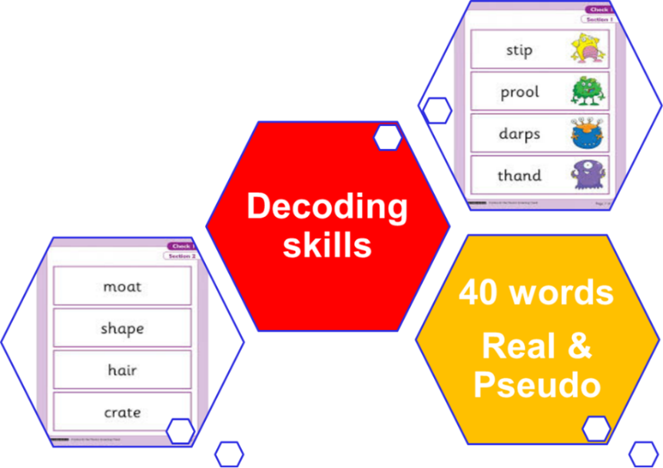
Phonics Screening Check
What is it?
The Phonics Screening Check is a test for children in Year One. Children take it during June in a one-to-one setting with their class teacher. During the Phonics Screening Check, children are asked to read (decode) 40 words. Most of these words are real words but some are pseudo-words.
Because some children may misread these pseudo-words based on their similarity to words in their existing vocabulary, each pseudo-word is clearly identified with an image of an alien. Most teachers and children, therefore, refer to pseudo-words as alien words.
Pass is currently 84%
Notes:
June – work 1-2-1 with teacher to read a list of words
NOT a reading test – purely assessing ability to decode – segment and blend
This is reported to parents in summer if children got the expected mark

Slide 28






Ready Steady Write
Ready Steady Write is the scheme that we follow for imparting the development of writing skills. An important part of the writing process is talking and allowing time for children to be creative, imaginative and innovative in their own writing.
Each half term we have a vehicle text that we introduce and use as a basis for different writing outcomes. We follow a process of immersing the children in the text. We then analyse the text before we plan and write our own. These units have been carefully mapped out to cover the entire statutory curriculum for English.
Notes:
Focus on grammar and punctuation
Immersed into a text as a stimulus for a half term
Exposure to an enriching vocabulary
Different writing purposes e.g. narrative ; recipe; reports
Plan; write; edit
Expectation that end of Y1 children use unfamiliar words ; spell them and include them in their writing

Slide 29
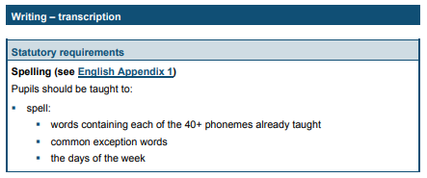
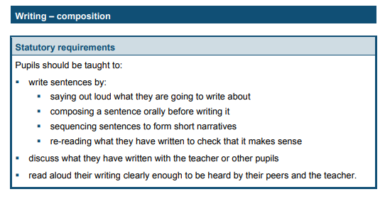
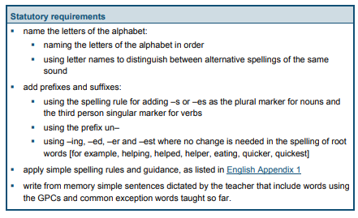
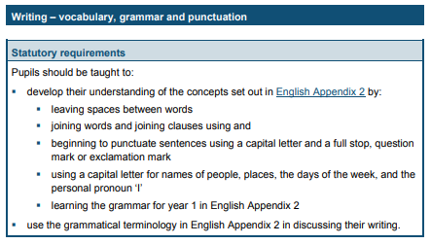
Writing Expectations Y1 NC

Slide 30
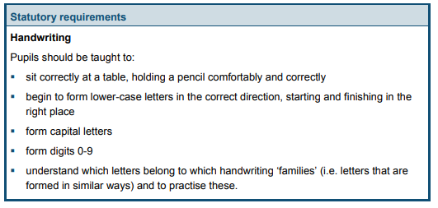
Handwriting expectations Y1 NC

Slide 31
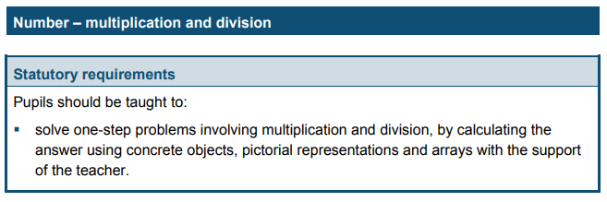
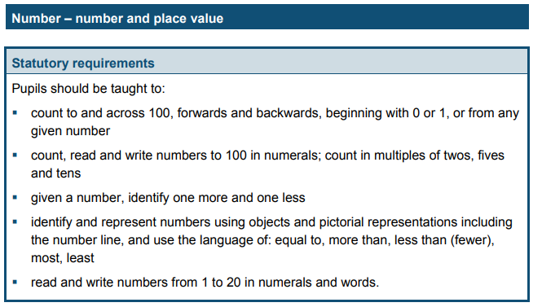
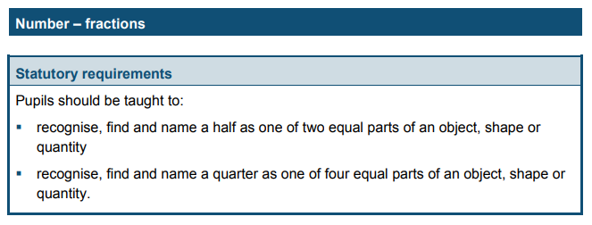
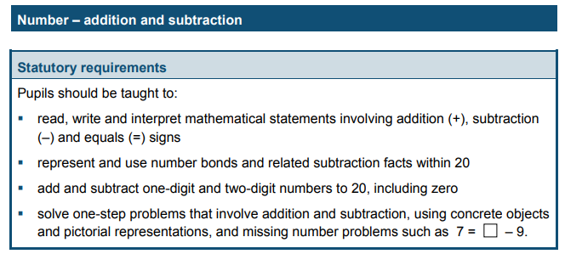
Maths Expectations

Slide 32
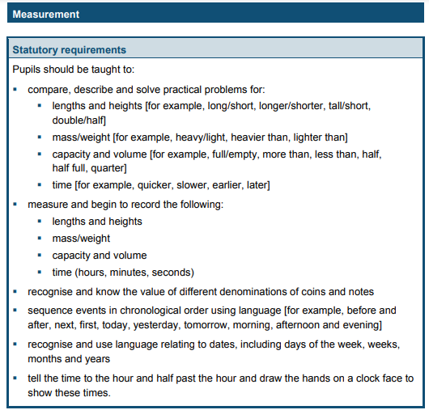
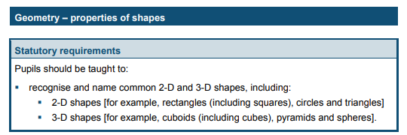
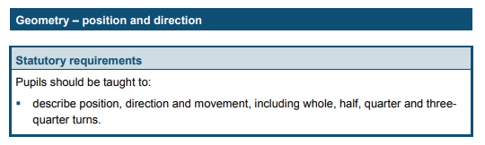
Maths Expectations continued…

Slide 33
Maths
Maths has 3 strands
Fluency
Reasoning
Problem Solving

Slide 34
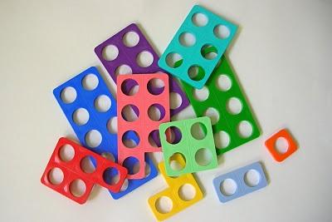


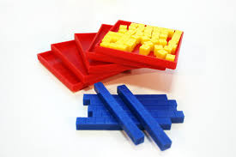


Concrete, Pictorial, Abstract
We begin mathematical teaching with concrete experiences.

Slide 35
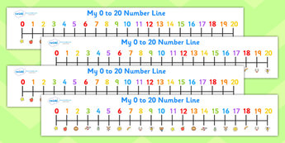
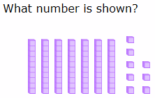
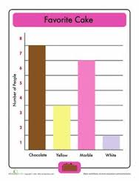
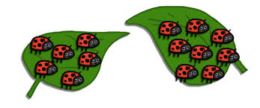
Pictorial representation
Using representations, such as a diagram or picture of the problem.

Slide 36
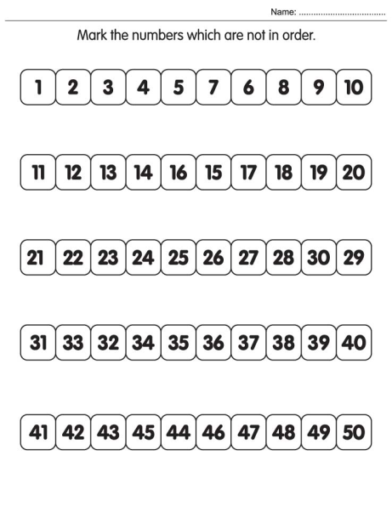
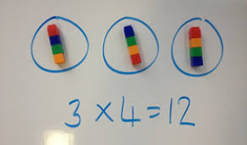
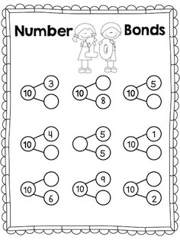

Symbolic/Abstract
Abstract representation The symbolic stage - a student is now capable of representing problems by using mathematical notation, for example: 5 + 3 = 8

Slide 37
Addition and Subtraction
Example…

Slide 38
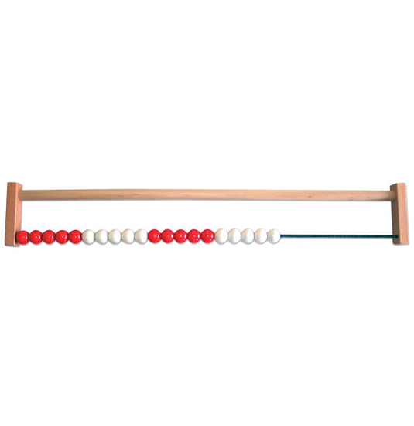
Key skills
Counting to and across 100 forwards and backwards from different numbers
Counting in 2’s,5’s and 10’s

Slide 39
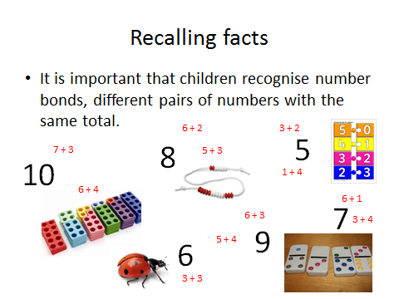

Slide 40
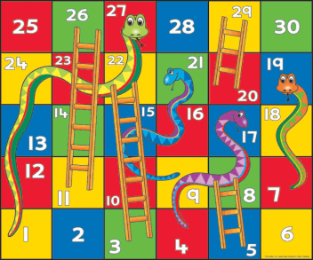

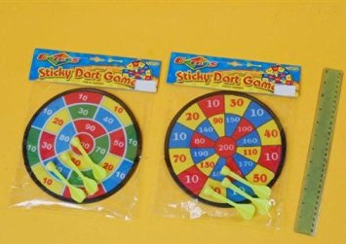
How you can help..
Clocks-talk about time during the day
Calendars- understanding of months and days of the week
Playing cards- Snap, one more/less, number bonds, ordering numbers
Board games involving dice
Measuring equipment- tape measures, measuring jugs
Velcro dartboard- doubling, halving
Fractions in real life-halving cakes, halving bars of chocolate, sharing equipment

Slide 41


Homework
Practising key skills
Chat challenge
Set on a Friday
return homework books by Wednesday
Notes:
Not too taxing.
Only a few minutes
Main focus – READING

Slide 42

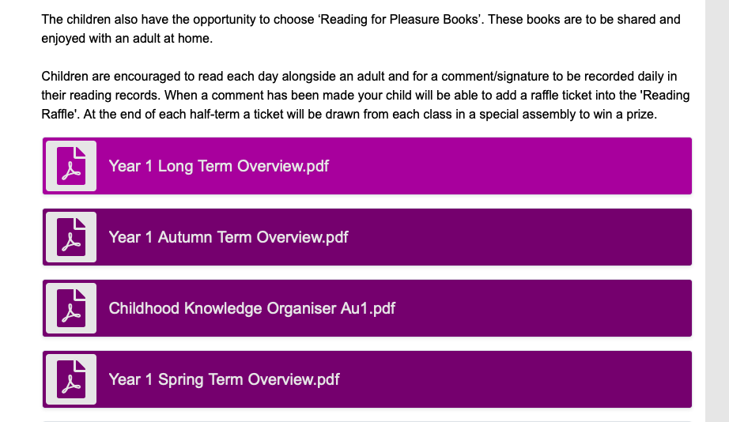
Black Horse Hill Infant School website
Year One Long Term Overview

Slide 43
End of year expectations
Working towards expected
Working at expected
Working at greater depth

Slide 44

Any questions?
If you have any questions please feel free to contact the school office via: schooloffice@blackhorsehill-infant.wirral.sch.uk
They will pass on your query to
your child’s class teacher.

