Slide 1
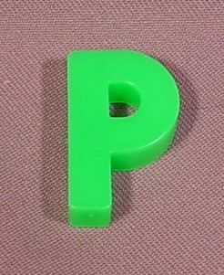
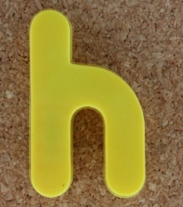
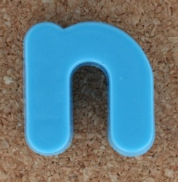
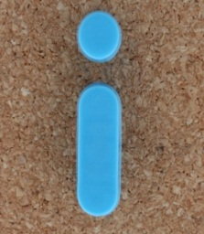
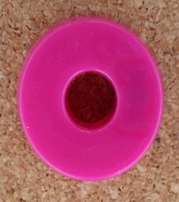
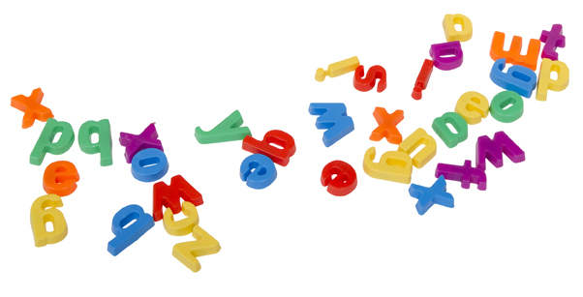

Slide 2
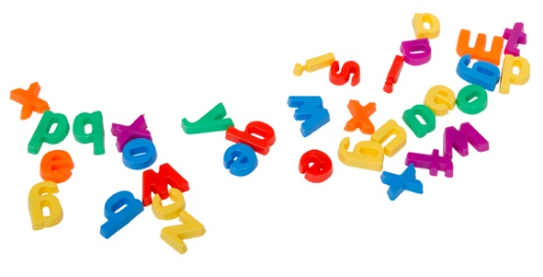
Why are we here?
To help parents/carers understand what phonics is and how it is taught in Foundation 2
For parents/carers to feel more able to support their child at home with phonics and reading

Slide 3
What is Phonics?
Phonics is a way of teaching children to read quickly and skilfully. The steps involved…
Recognising the sounds that each individual letter makes.
Identifying the sounds that different combinations of letters
make e.g. sh ch
Blending these sounds together from left to right to
make a word.

Slide 4
Key Terminology
Phoneme – The smallest unit of sound
Grapheme – The letter(s) representing a sound
Blending – Blend sounds to form words c-a-t (reading)
Segmenting – Breaking words down into individual sounds (spelling)
Digraph – Two letters that make one sound sh o p
Trigraph – Three letters make one sound l igh t

Slide 5
d o g t e n t
Blending
We use sound buttons
sh ar p
sharp

Slide 6
Phonic Phases
Phase 1
Develops children's abilities to listen to, make, explore and talk about sounds.
Phase 2
Set 1: s a t p
Set 2: i n m d
Set 3: g o c k
Set 4: ck e u r
Set 5: h b f ff l ll ss
Phase 3
Set 6: j, v, w, x
Set 7: y, z, zz, qu
Consonant digraphs: ch, sh, th, ng
Vowel digraphs and trigraphs: ai, ee, igh, oa, oo, ar, or, ur, ow, oi, ear, air, ure, er

Slide 7
Phase 4 (Expected)
The purpose of this phase is to consolidate children’s knowledge of reading and spelling of words with adjacent consonants and polysyllabic words
Adjacent consonants blends help children decode longer words e.g. truck help
Polysyllabic words – Words with more than one syllable
e.g. Helpdesk Sandpit Lunchbox

Slide 8
Phase 5 (Exceeding)
The purpose of this phase is to broaden a child’s knowledge of graphemes for use in reading and spelling.
New graphemes introduced
Alternative pronunciations – enables children to select appropriate graphemes in order to spell correctly
e.g. ‘o’ hot cold or ‘ow’ cow blow
New selection of tricky words introduced

Slide 9
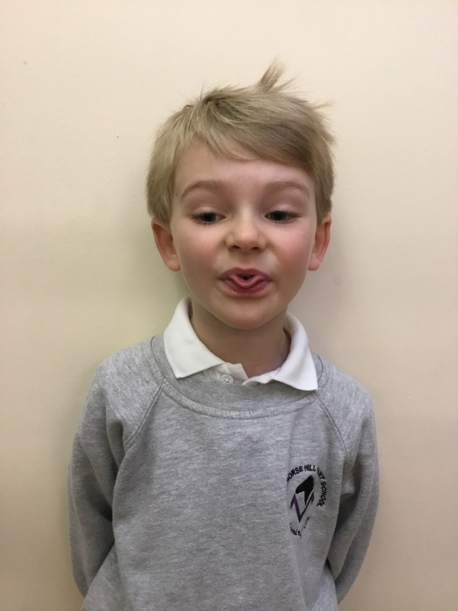
The Articulation of Phonemes
Common
Misconceptions
‘ f ’ and ‘ th ’
three
Incorrect pronunciation will have implications for reading and spelling

Slide 10
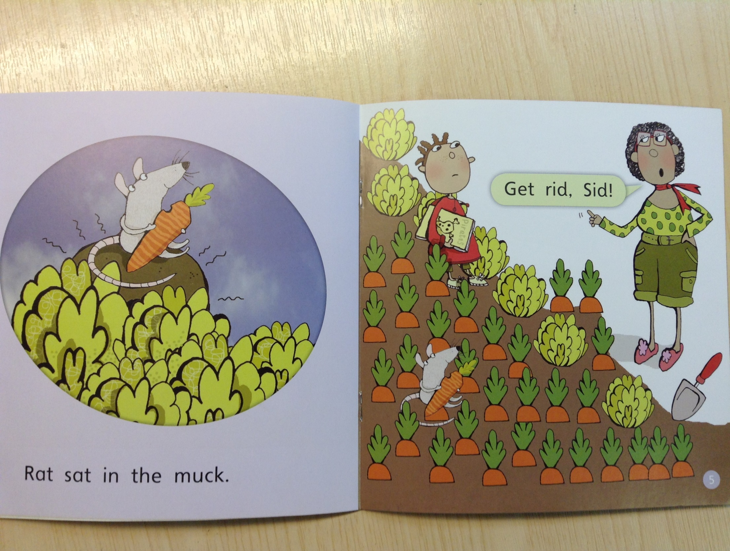
Children must learn the letter names
in addition to the sound they make
G/g
R/r

Slide 11
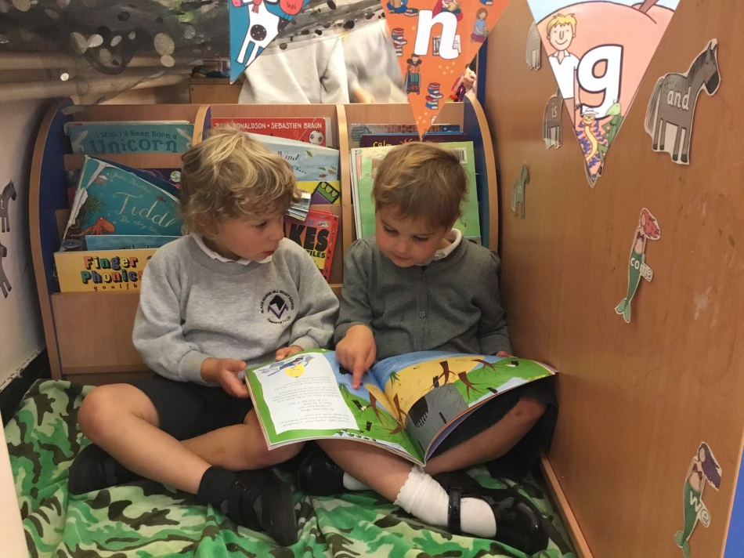
Learning Tricky Words
the

Slide 12
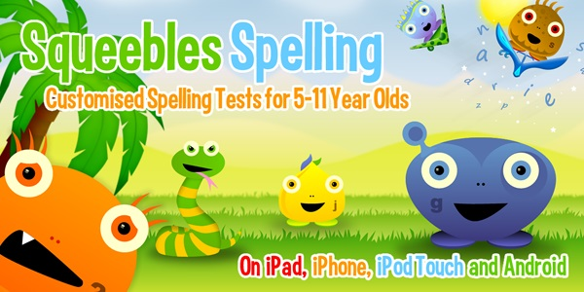
Useful Websites & Apps
www.phonicsplay.co.uk (Click on free resources)
www.ictgames.com (Click on the literacy section)
App available to
download £3.99

Slide 13
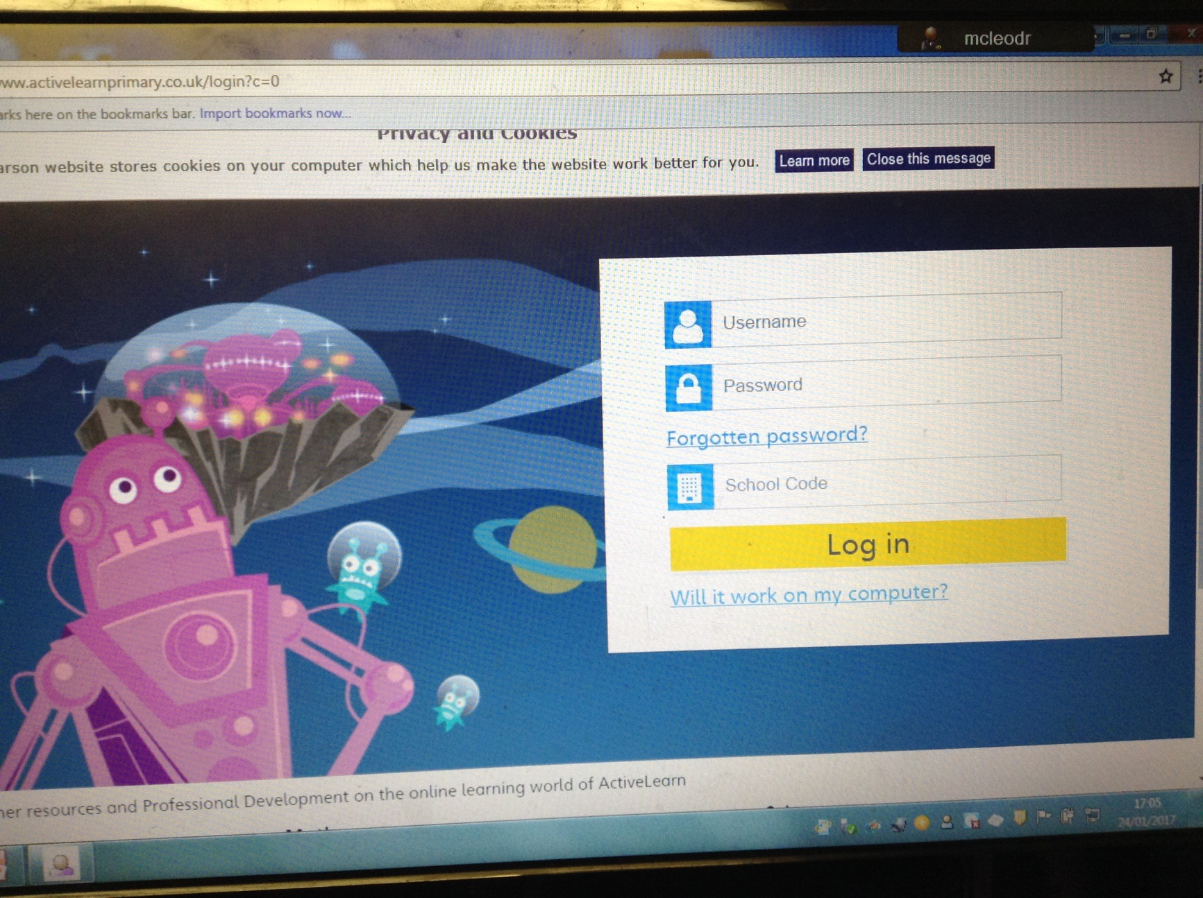
Active Learn - Online Books

Slide 14
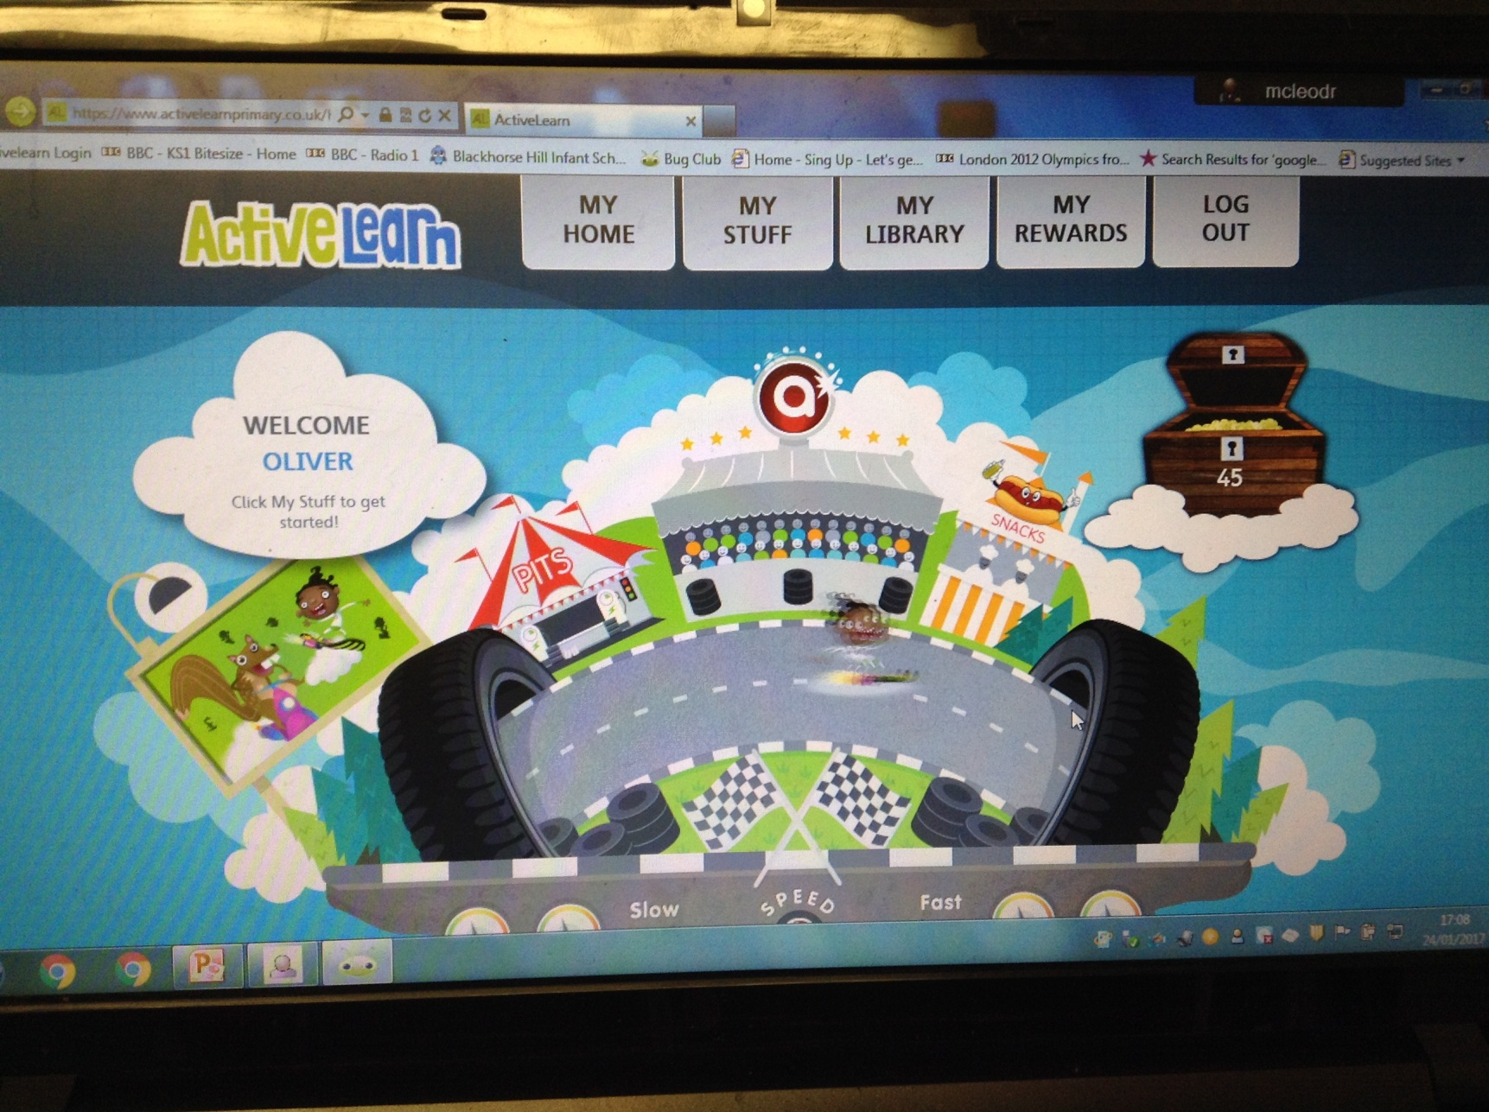
Active Learn - Online Books

Slide 15
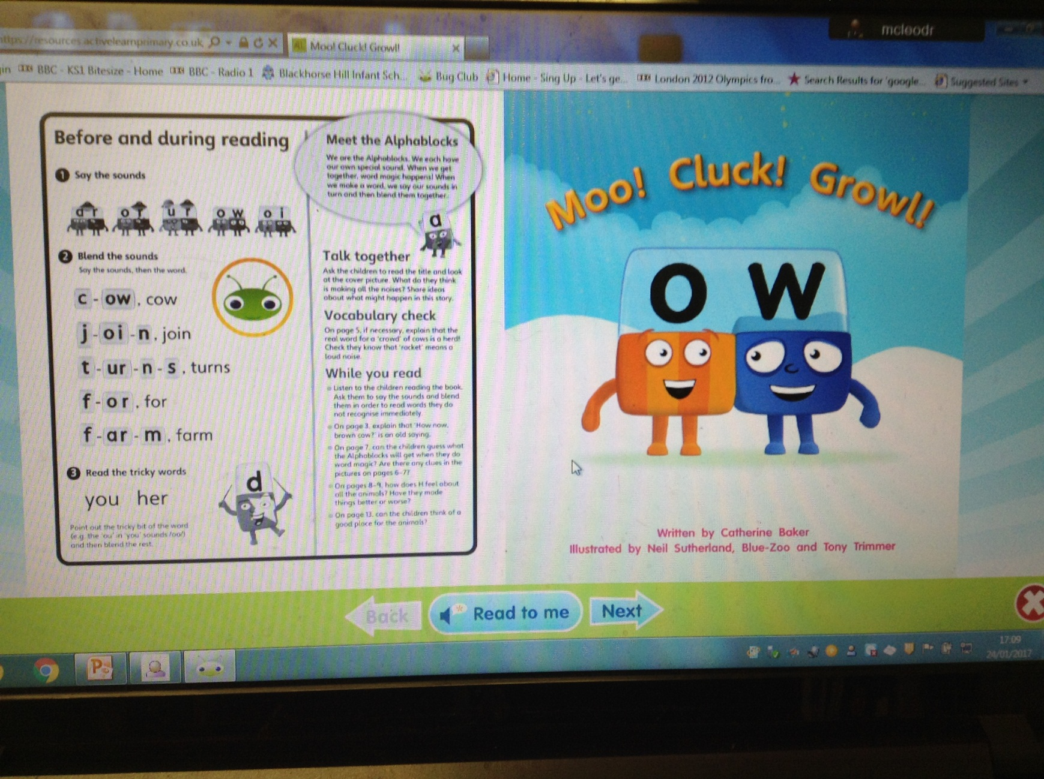
Active Learn - Online Books

Slide 16
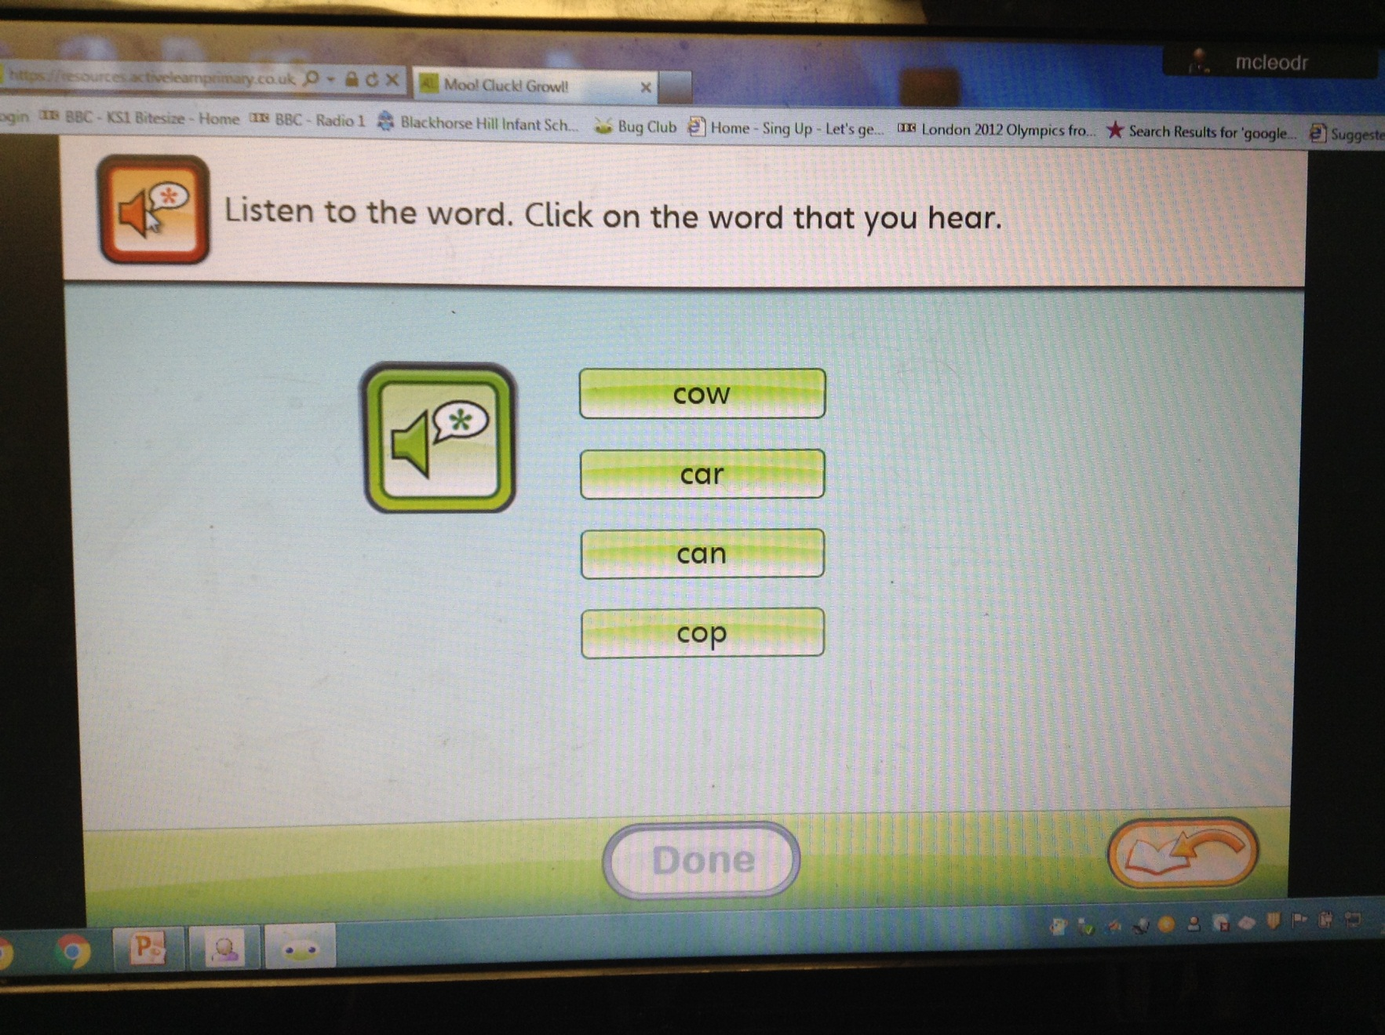
Active Learn - Online Books

Slide 17
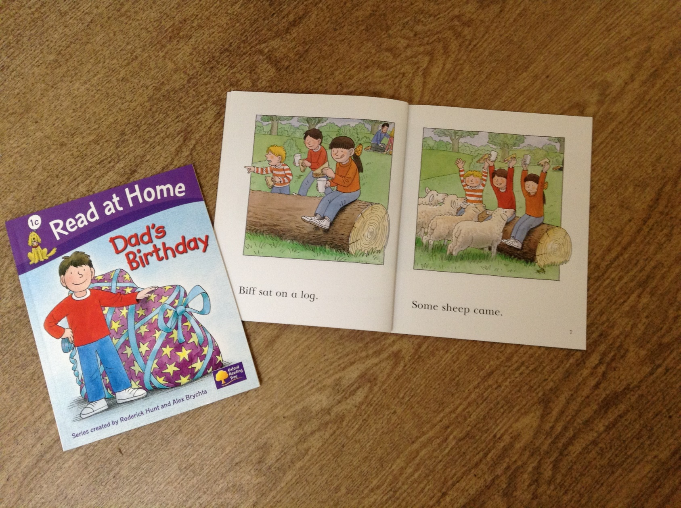
Books that contain more ‘Tricky Words’

Slide 18
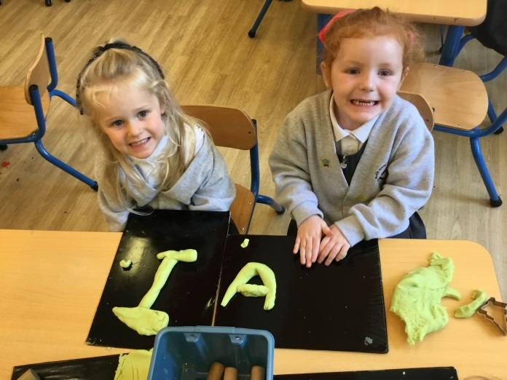
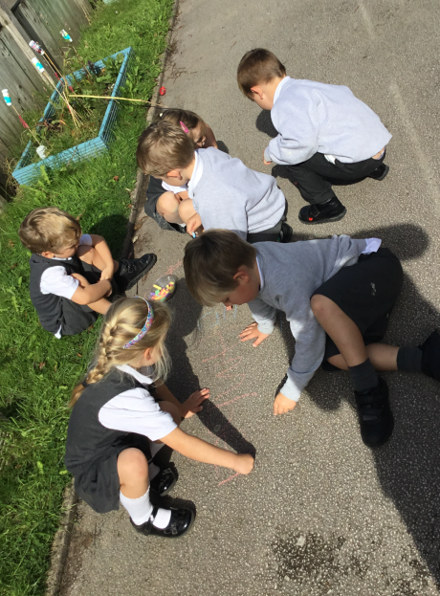
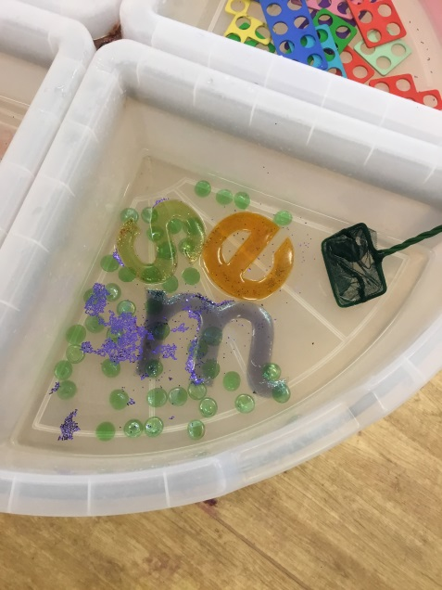
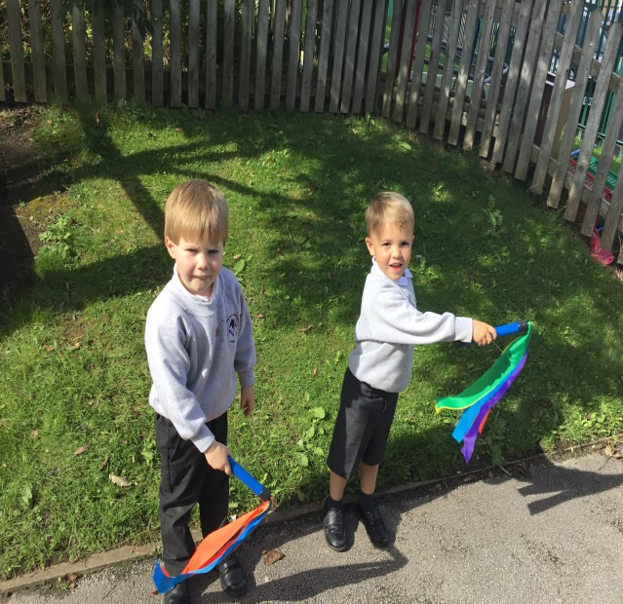
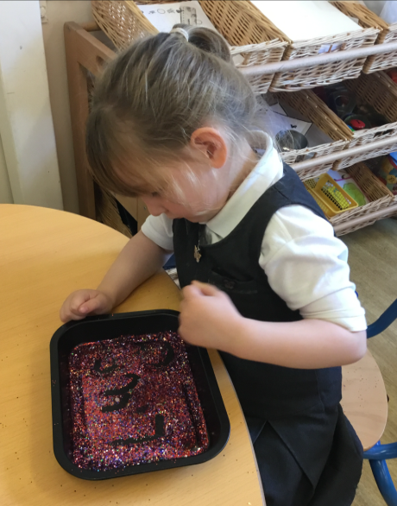
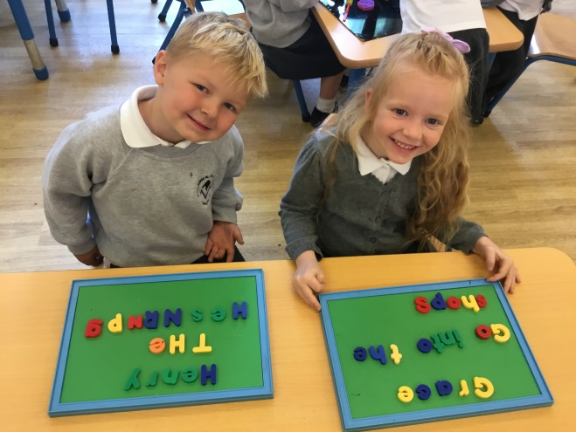
Learning through Play

Slide 19
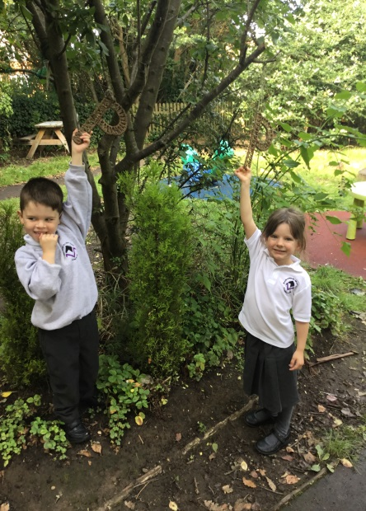
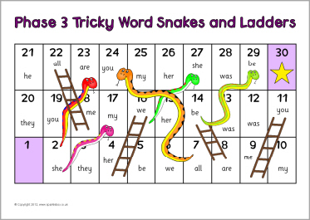
Sight Recognition
Playing games that involve looking at a combination of letters that together form a tricky word
Tricky word splat
Squirt the tricky word
Tickle the tricky word
Tricky word hunt
Tricky word snakes and ladders

